Slide 1
It’s Time to Enroll Get to Know Your VSP Vision Benefits.
Segal Group
Open Enrollment is Oct. 25 – Nov. 8, 2023 Effective January 1, 2024
Notes:
Generic Script:
Thank you for taking the time to learn more about your benefit offering through VSP Vision Care! With VSP Vision Care, our goal is to help you see well and be well for a lifetime of good vision. Let’s take a look at the great benefits available to you.

Slide 2
Why VSP?
Notes:
Generic Script: Why should you enroll in vision care coverage with VSP? Let’s take a look.

Slide 3
See Well. Be Well.®
Care
As a health-focused company, your well-being is at the core of everything we do. Eye care is essential to your overall health.
Savings
With VSP®, your family can rely on additional savings and offers to get the care you need at low out-of-pocket costs.
Access
From private practice doctors to retail chain locations, VSP is here to help you with safe, convenient access to local eye doctors.
Notes:
Generic Script:
As a health focused company, your well-being is at the core of everything we do. With VSP, you’ll get convenient access to the personalized care you need with savings you can rely on.

Slide 4
Eye Care is Essential
Keep yourself healthy with a yearly eye exam from a VSP network doctor. Did you know?
Annual eye exams provide an unobstructed view of the blood vessels and can help detect early signs of serious eye and health conditions like glaucoma, diabetes, high cholesterol, and high blood pressure.
Nearly 96 million US adults are living with pre-diabetes and 84% don’t know they have it.*
*Centers for Disease Control and Prevention (CDC)
Notes:
Generic Script: Keep yourself healthy with a yearly eye exam from a VSP network doctor. Even if you have 20/20 vision, it’s important to get an eye exam every year. You may wonder ‘what’s so important about an eye exam’ or ‘why is a vision exam an important component in preventive care. And it’s because the eyes are the only place in the body that provides a non-invasive, unobstructed view of blood vessels. This allows eye doctors the ability to detect signs of conditions like diabetes, diabetic retinopathy, high cholesterol and hypertension. Regular eye exams can reduce the risk of diabetes related vision loss by 95%.* And a VSP WellVision® Exam can reveal health conditions, even if you don’t have symptoms.
*Centers for Disease Control and Prevention (CDC)

Slide 5
Best Value for Your Dollar
Here’s an example of your potential savings as an individual when you receive an eye exam and get new prescription glasses. Families save even more!
 | Without VSP | With Your VSP Plan
Eye Exam | $194 | $15 copay
Frame | $120 | $15 copay
Single Vision Lenses | $107
Anti-glare Coating | $149 | $0
Light-reactive Lenses | $128 | $0
Employee-only Annual Contribution | N/A | $165.24
Total | $698 | $195.24
Estimated Annual Savings
$502.76
Based on state and national averages for eye exams and most commonly purchased brands. This chart represents average savings for VSP members. Your actual savings will depend on the eyewear you choose, the plan available to you, your copays, your premium, and whether it is deducted from your paycheck pre-tax.
Notes:
Generic Script: Now let’s dive into the great benefits and savings you get as a VSP member. Savings are built into your plan, which means you'll get a great deal on services, like:
Eye exams from the nation's top providers
Fashionable frames and prescription glasses and sunglasses
Lens enhancements, like anti-glare coating and light-reactive lenses
You’ll also enjoy savings on additional lens enhancements and contact lens services. Based on applicable laws, benefits may vary by location.

Slide 6
Your VSP Plan Options at a Glance
 | Segal’s Base Plan | Segal’s 2nd Pair Buy-Up Plan
Exams | WellVision Exam covered every calendar year $15 Copay Retinal imaging exam covered every calendar year $39 Copay
Essential Medical Eye Care | Retinal imaging for eligible members with diabetes Additional exams and services beyond routine care to treat immediate issues from pink eye to sudden changes in vision or to monitor ongoing conditions such as dry eye, diabetic eye disease, glaucoma, and more Coordination with your medical coverage may apply. Ask your VSP network doctor for details. | Essential Medical Eye Care
Frame Allowance | $150 Frame allowance Every Calendar Year | $150 Frame allowance Every Calendar Year
Lenses (every calendar year) | Fully covered single vision, lined bifocal, or lined trifocal lenses Impact-resistant lenses for dependent children
Lens Enhancements | Standard Progressive lenses covered in full Scratch-Resistant & Anti-Reflective coatings covered in full Tints & Photochromic lenses covered in full Average 35-40% average savings on lens enhancements, like UV coatings, Premium & Custom Progressives Lenses | Standard Progressive lenses covered in full Scratch-Resistant & Anti-Reflective coatings covered in full Tints & Photochromic lenses covered in full Average 35-40% average savings on lens enhancements, like UV coatings, Premium & Custom Progressives Lenses
Contact Lens Allowance (instead of glasses) | $150 allowance for contacts and contacts lens exam (fitting and evaluation, with a $60 copay) | $150 allowance for contacts and contact lens exam (fitting and evaluation, with a $60 copay)
Additional Pair of Eyewear | N/A | Covered second pair of glasses or contact lenses at same allowances as first pair benefits
Your Monthly Contribution | $13.77 Member only | $27.37 Member + 1 | $44.00 Member + family | Add to the Base Plan Cost: $8.33 Member only | $16.25 Member + 1 |$25.96 Member + family
Notes:
Generic Script:
Here’s a look at the benefits available to you. When you choose a VSP vision plan, you will receive a WellVision Exam covered every year.

Slide 7
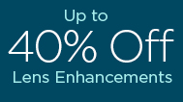
Exclusive Member Extras
Get the Savings You Need.
Visit vsp.com to see all the Exclusive Member Extras. VSP puts members first by providing you with exclusive special offers from leading industry brands, totaling more than $3,000 in savings. Discover great deals on glasses, sunglasses, contact lenses, and more.
Enjoy an Extra $20 on Featured Frame Brands. Save up to 40% on popular lens enhancements*. Offers vary based on state and benefit plan. Brands and offers subject to change.
*Savings based on doctor’s retail price and vary by plan and purchase selection; average savings determined after benefits are applied. Ask your VSP network doctor for more details.
Notes:
Generic Script:
At VSP, our commitment to your well-being extends to your financial wellness. Members get access to Exclusive Member Extras--up to $3,000 in savings on leading industry brands. Plus, VSP members always get an extra $20 to spend on featured frame brands. That way you get the low-out-of-pocket costs your family needs.
Exclusive Member Extras includes:
Special deal on glasses – extra $20 on featured frame brands
Up to 40% off lens enhancements
Visit vsp.com to see additional savings on contacts, LASIK, diabetes care, hearing aids, and financing
Offers vary based on state and benefit plan. Brands and offers subject to change.

Slide 8
Convenient Access You Want
With thousands of in-network doctors, it’s easy to find an eye doctor near you.​ With Even More Options
Maximize your benefits at a Premier Program location (at no extra cost) including thousands of private practice doctors and more than 700 Visionworks® retail locations nationwide.
Exclusive bonus offers and savings
A wide selection of featured frame brands
Advanced eye exam technology, like retinal imaging
Notes:
Generic Script:
No matter where you’re located, you have convenient access to a VSP provider.
As a member, you can maximize your benefits when you visit a Premier Program location, including:
Exclusive bonus offers available only at Premier Program locations
A wide selection of featured frame brands, backed by a one-year worry-free warranty if your glasses are broken or damaged
Access to the latest in high-definition technology with UNITY® digital lenses available
Advanced eye exam technology, like retinal imaging

Slide 9
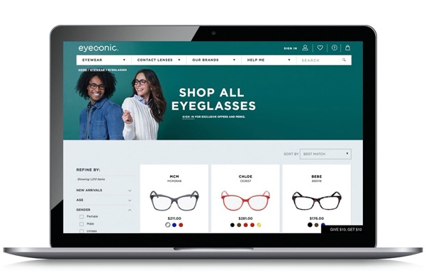
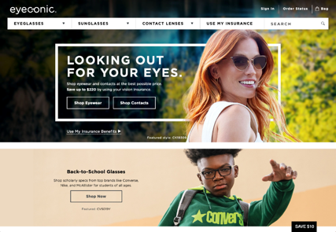
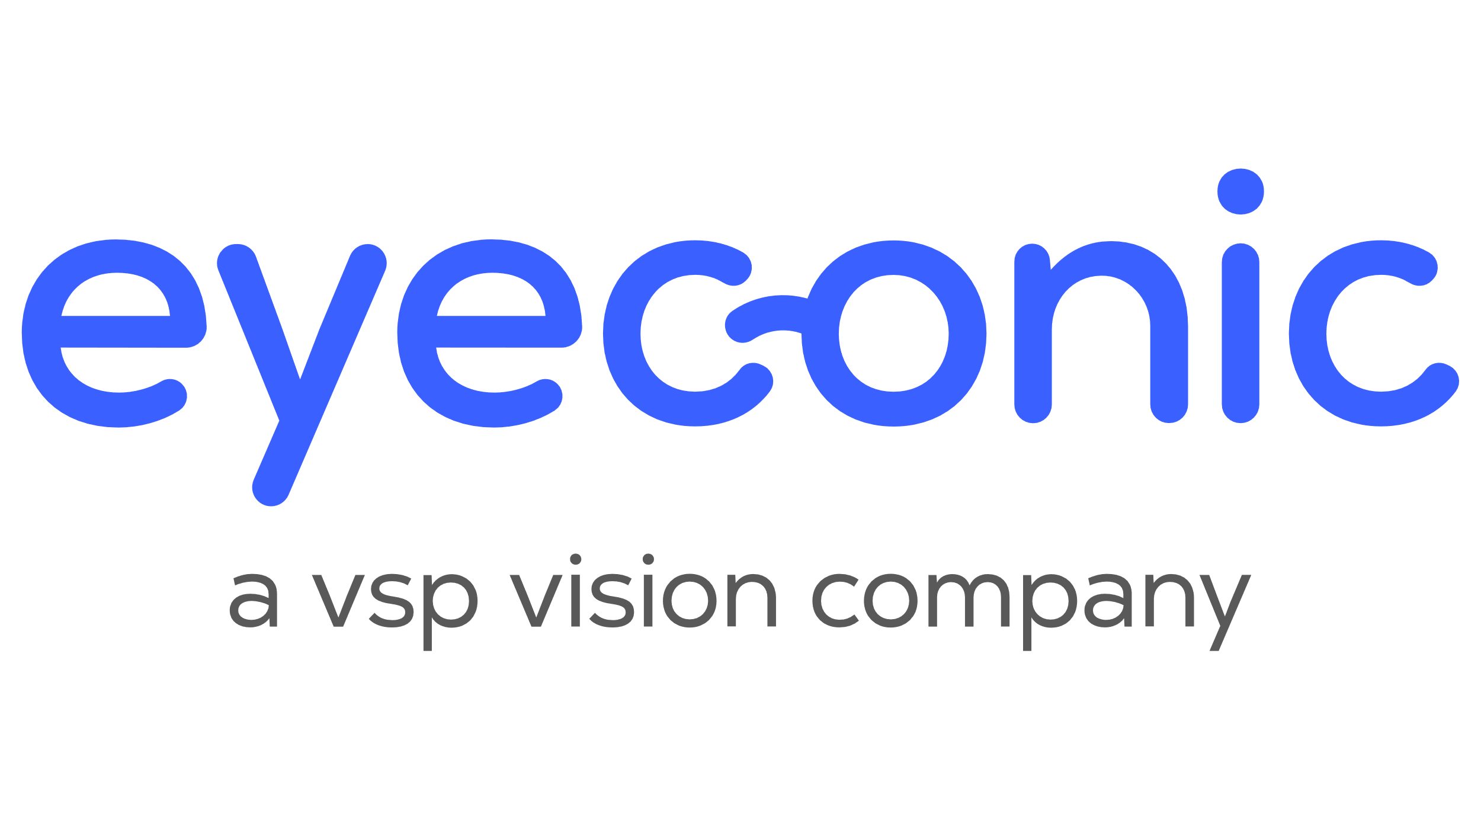
Eyeconic
As a VSP-owned company, Eyeconic seamlessly connects your VSP vision benefits to your account.
Eyeconic offers a variety of well-known brands and contact lenses. Choose from more than 70 eyewear brands like Calvin Klein, Cole Haan, Nike, and more. Find your product, customize your order and we do the rest. Start saving today at eyeconic.com® today.
Notes:
Generic Script:
As a VSP-owned company, Eyeconic is the only website that seamlessly connects VSP vision benefits to a members’ account. By applying your vision benefits, you see savings in real time.
Save time and money on quality eyewear with a few easy clicks.
1. Connect your vision insurance
2. Select your product
3. Upload your prescription or provide your doctors contact information and we’ll take care of the rest.
Eyeconic offers a variety of well-known name brands and contact lenses. Choose from over 70 eyewear brands and over 1600 styles.

Slide 10
Using Your Benefit is Easy
Once you’re enrolled…
Create an account at vsp.com and review your personalized benefit information.
You can find a VSP in-network doctor by visiting vsp.com or calling 800.877.7195.
At your appointment, simply tell them you have VSP. No ID card needed—and we’ll take care of the rest! There are no claim forms to fill out when you see a VSP network doctor.
Notes:
Generic Script:
And using your VSP benefit is easy. Once your plan is effective, create an account on vsp.com to review your personalized benefit information and easily search for an in-network doctor so you can find a provider who's right for you. And don’t forget you can maximize your benefits when you visit a Premier Program location. Then, at your appointment, simply tell the doctor’s office you have VSP. There’s no ID card needed or claim forms to complete when you see a VSP network doctor.

Slide 11
Essential Medical Eye Care
Here’s what’s covered:
Fully covered retinal imaging for members with diabetes who do not have diabetic eye disease.
Exams and services to treat immediate issues like pink eye and sudden changes in vision.
Treatment options to monitor ongoing conditions such as dry eye, diabetic eye disease, glaucoma, and more.
This coverage is supplementary and in most cases your health insurance will be billed first. You may be able to coordinate with your VSP benefits in order to help reduce out-of-pocket costs. If your VSP network doctor doesn’t participate with your medical insurance plan, VSP has you covered with only the cost of your copay.*
*$20 standard copay for medical exams. Other covered services are covered-in-full, including retinal screening for members with diabetes.
Notes:
Please use this slide if your client has Essential Medical Eye Care. If your client does not have Essential Medical Eye Care, delete this slide.
Generic Script:
With Essential Medical Eye Care, here’s what’s covered:
Fully covered retinal screening for members with diabetes who do not have diabetic eye disease
Exams and services to treat immediate issues like pink eye and sudden changes in vision
Treatment options to monitor ongoing conditions such as dry eye, diabetic eye disease, glaucoma, and more
This coverage is supplementary and in most cases your health insurance will be billed first. You may be able to coordinate with your VSP benefits in order to help reduce out-of-pocket costs. If your VSP doctor doesn’t participate with your medical insurance plan, VSP has you covered with only the cost of your copay.

Slide 12
Enroll Today!
VSP helps you see well and be well with the coverage and quality care you deserve.
Questions? Contact us. Call 800.877.7195 or visit VSP.com.
©2022 Vision Service Plan. All rights reserved. VSP, WellVision Exam, and "See Well. Be Well." are registered trademarks of Vision Service Plan. All other brands or marks are the property of their respective owners. 102051 VCCM
Classification: Confidential
Notes:
Generic Script:
VSP helps you see well and be well with the coverage and quality care you deserve. To learn more, contact us by calling VSP Member Services or by visiting us online at vsp.com.

